Slide 1




NON-LINEAR DYNAMICS
COURSE PRESENTATION
MUSICAL VARIATIONS
FROM A CHAOTIC
MAPPING
A collaborative effort by
-Aditya Choudhury
-Arya Jha
-Devesh

Slide 2
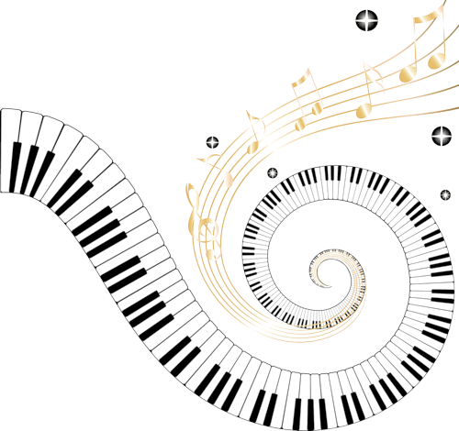
CREATING VARIATION IN PATTERNS
GENERATING VARIATIONS IN ANY PATTERN CAN PROVE TO BE USEFUL
FOR EXAMPLE, DNA OR PROTEIN SEQUENCE, PIXEL SEQUENCES OF ARTWORK, WORD SEQUENCES FROM POETRY AND SO ON
WE WILL TRY TO DEMONSTRATE THIS IN THE CONTEXT OF MUSIC

Slide 3

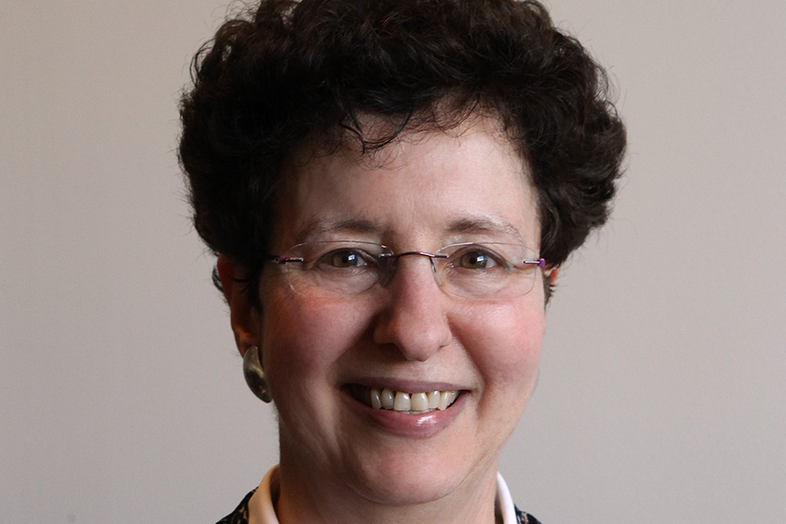

MUSICAL VARIATIONS FROM A CHAOTIC MAPPING
Diana Dabby was a student of Steven Strogatz
She is the music director of Olin College of Engineering
She thought of an interdisciplinary linking of musical variations and chaos
D. S. Dabby, “Musical variations from a chaotic mapping,” Chaos: An Interdisciplinary Journal of Nonlinear Science, vol. 6, no. 2, pp. 95–107, Jun. 1996, doi: 10.1063/1.166171.

Slide 4
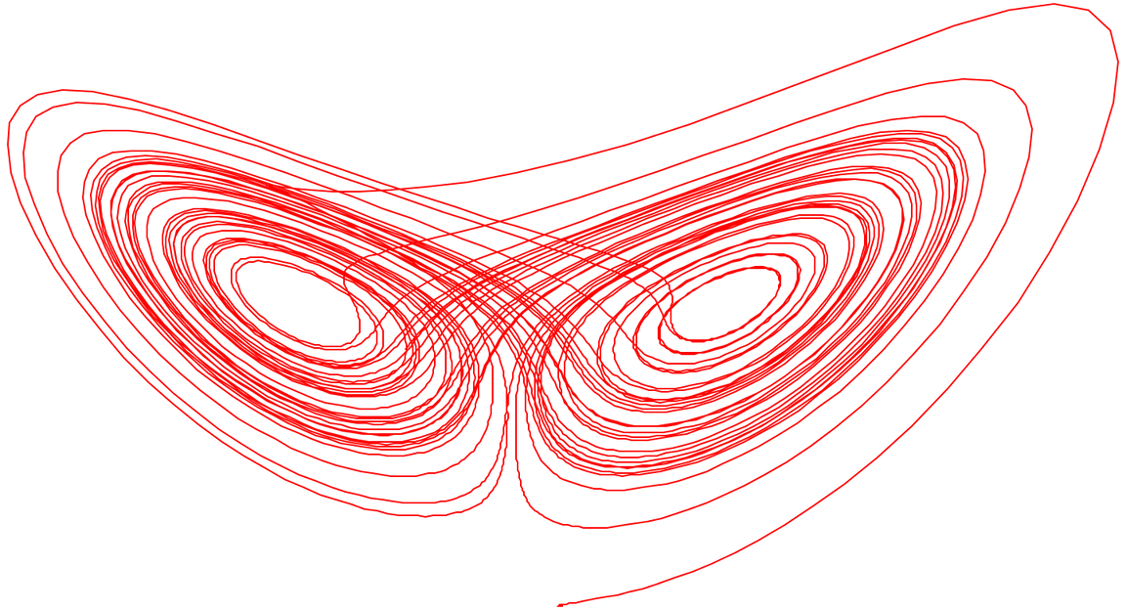

CHAOTIC MAPPING
Lorenz Equations
source: wikipedia
We can map the output of a chaotic system to any of the musical attributes.

Slide 5
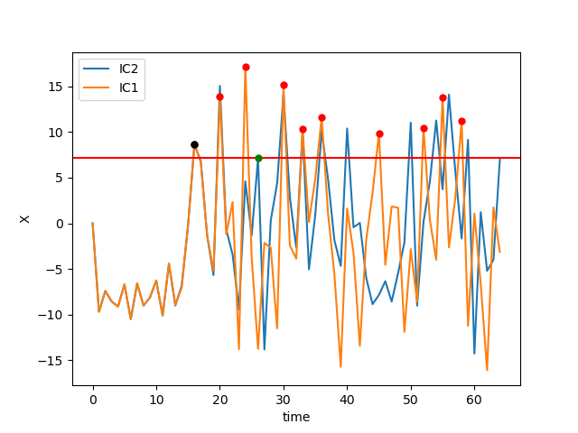
MAPPING LOGIC
We Choose the Next immediate Highest Point from IC2 for a given IC1

Slide 6

MUSICAL JARGON
BARS
A SEGMENT OF MUSIC BOUNDED BY VERTICAL LINES INDICATING RECURRING BEATS. LENGTH INDICATED BY TIME SIGNATURE
CHORDS
any harmonic set of pitches consisting of multiple notes that are sounded simultaneously, or nearly so
OCTAVES
the interval between one musical pitch and another with double or half its frequency. For example, if one note has a frequency of 440 Hz, the note one octave above is at 880 Hz, and the note one octave below is at 220 Hz

Slide 7
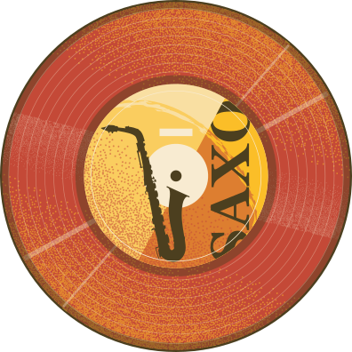
WHY EXACTLY
8 BARS?
Diana Dabby’s paper only used 11 bars of music
We generated a variation using only 8 bars at a time
Every 8 bars we restarted from a different ivp

Slide 8

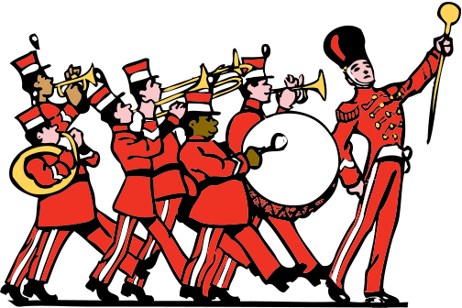
WORKING WITH CHORDS
This is where we decided to start working on
something new
A chord, in music, is any harmonic set of pitches
consisting of multiple notes that are sounded
simultaneously, or nearly so
initially all the chords being used are single notes
or octaves
WHY DO CHORDS WORK BETTER?
chords are lesser in number
repetitive
therefore, controlled in a better way and desired
patterns repeat in the piece

Slide 9

FULL
CHORDS
HARMONIC PROGRESSION
Harmonic chords (minors or majors, minor in this case)
here, we see that they blend pretty well because of the same reason of chords being a systematic (not so random) group of notes

Slide 10
MULTIPLE MELODIES
Why do multiple melodies not work?
Many different notes!
SDIC results in two melodies, which sound fine by themselves but are completely different from each other
Unlike chords, the melody can have different notes without the harmonic linking of chords!

Slide 11
LIMITATIONS
Considering full sequence of bars leads to us losing the sound of the original melody
In the original paper all the notes are of equal time length, we had notes of varying length, for which we had to make our own model
Multiple variations of a melody couldn’t overlap well with each other

Slide 12
WHY CHAOS?

Slide 13
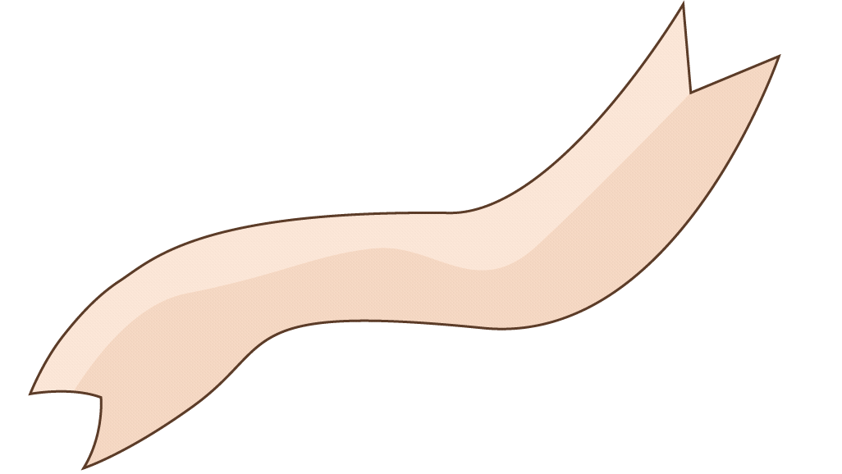
THANK
YOU
CONTACT US
WE'D LOVE TO HEAR FROM YOU!
MAILING ADDRESS
123 Anywhere St., Any City, State, Country 12345
EMAIL ADDRESS
hello@reallygreatsite.com
PHONE NUMBER
(123) 456 7890

